Slide 1
Computer Architecture
Week 9

Slide 2
Objectives
Continue to look at control transfer instructions
Unconditional control transfer
Subroutines using jal and ret
Conditional control transfer
Branch statements

Slide 3
Jump instructions
We have seen how to use
jal to jump to the code following a label (set the pc to the address of that code) and store the address of the instruction after the jal in register ra
ret to set the program counter back to the address stored in ra

Slide 4
Branching
Allows conditional changes in execution path
Then we can code if/else type statements and loops
Based on some condition we either continue on the code path or move to a different part of the program
There are many different variations of branch instructions in RISC-V basic and pseudo-instructions. We will only look at a few of them.

Slide 5
Example branch instructions in RISC-V
Conditional basic instructions
Go directly to the instruction after the label if register1 is not equal to register2
bne, register1, register2, label
Go directly to the instruction after the label if register1 is greater than or equal to register2
bge, register1, register2, label
Go directly to the instruction after the label if register1 is less than register2
blt, register1, register2, label
Unconditional branch (pseudo instruction)
Go directly to the instruction after the label
b label
Notes:
Note there are many more

Slide 6
Pass or fail?
Suppose we want the user to input their mark and the program will tell them if it’s a pass or a fail
Get the user input into a register
Assume that the user inputs an integer in the correct range (0 to 100)
Compare the mark to 40
Store 40 in a register (I’ll use t0)
Multiple ways to approach this
If the mark is greater than or equal to 40
It is a pass
Otherwise,
It is a fail

Slide 7
Pass or fail? Approach 1
Check if the grade is greater than or equal to 40
Using branch greater than or equal to bge
If the input result is greater than or equal to 40 then branch to code for a pass
Otherwise, when the branch wasn’t followed it is a fail
In that case make sure to skip the code for a pass using branch (b)

Slide 8
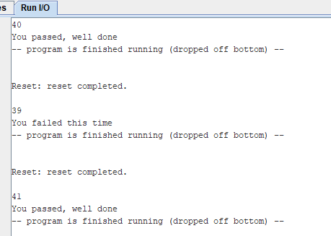
Pass or fail – 1
.data
msgPass: .string "You passed, well done"
msgFail: .string "You failed this time"
.text
addi a7, zero, 5
ecall
addi t0, zero, 40
bge a0, t0, pass
la a0, msgFail
b output
pass:
la a0, msgPass
output:
addi a7, zero, 4
ecall
The program will continue to the instruction after the bge when the value is not greater than 40
Receive integer input from the user and store in register a0
Store 40 in register t0
If a0 is greater than or equal to t0, go to pass
These lines run if we didn’t branch to pass
We need to skip the load of the pass message

Slide 9
Pass or fail? Approach 2
Check if the grade is less than 40
Using branch less than blt
Branch to code for fail if grade is less than 40
Otherwise, when branch wasn’t followed it is a pass
If the input result is less than 40 then branch to code for a fail
Otherwise, when the branch wasn’t followed it is a pass
In that case make sure to skip the code for a fail using branch (b)

Slide 10
Pass or fail – 2
.data
msgPass: .string "You passed, well done"
msgFail: .string "You failed this time"
.text
addi a7, zero, 5
ecall
addi t0, zero, 40
blt a0, t0, fail
la a0, msgPass
b output
fail:
la a0, msgFail
output:
addi a7, zero, 4
ecall
Using blt
The program will continue to the instruction after the blt when the value is not less than 40
Receive integer input from the user and store in register a0
Store 40 in register t0
If a0 is less than t0 then go to fail
These lines run if we didn’t branch to fail

Slide 11
Which instruction do we use to always branch without testing any condition?
bne
b
beq

Slide 12
Checking for equality
Suppose we are trying to code a guess the number game where the computer generates a random number (say between 1 and 100) and the player has to guess it
There are system calls available in RARS to set up a random number
We would need to provide hints as to whether the guess was too high or too low
For now we will just look at checking whether the guess was correct or not

Slide 13
Checking for equality – using bne
RISC-V assembly code
# relate registers to java code
# s0 = secret, a0 = guess
bne s0, a0, wrong
# load address of win message
# branch to continue
wrong:
# load address of lose message
continue:
# output the message
Java Code
if (guess == secret)
// correct
else
// wrong
Assembly tests opposite case (i != j) of high-level code (i == j)

Slide 14
Checking for equality – using beq
Java Code
if (guess == secret)
// correct
else
// wrong
RISC-V assembly code
# relate registers to java code
# s0 = secret, a0 = guess
beq s0, a0, win
# load address of lose message
b continue
win:
# load address of win message
continue:
# output the message

Slide 15
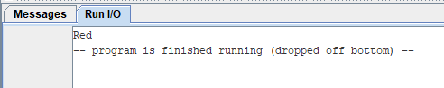
What would this code output?
.data
red: .string "Red "
blue: .string "Blue "
.text
addi a7, zero, 4 # to output a string
addi t0, zero, 3
addi t1, zero, 4
bge t0, t1, choice
la a0, red
b output
choice:
la a0, blue
output:
ecall
Nothing
Red Blue
Red
Blue

Slide 16
What does the code output now?
.data
red: .string "Red "
blue: .string "Blue "
.text
addi a7, zero, 4 # to output a string
addi t0, zero, 4
addi t1, zero, 4
bge t0, t1, choice
la a0, red
b output
choice:
la a0, blue
output:
ecall
Nothing
Red Blue
Red
Blue
The code won’t run

Slide 17
Pseudo instructions
Pseudo instructions are not actual RISC-V instructions, but they are often more convenient for the programmer
Assembler converts them to real RISC-V instructions.

Slide 18
Some pseudo instructions for conditional branching
Go directly to the instruction after the label if register1 is equal to zero
beqz, register1, label
Go directly to the instruction after the label if register1 is not equal to zero
bnez, register1, label
Go directly to the instruction after the label if register1 is greater than register2
bgt, register1, register2, label
Notes:
Note there are many more

Slide 19
What does the pseudo instruction bgez stand for?
1
Branch if greater than zero
0%
2
Branch if equal to zero
0%
3
Branch if greater than or equal to zero
0%

Slide 20
What would the pseudo instruction ble stand for?
1
Branch if less than or equal to
0%
2
Branch if less than
0%
3
Branch always
0%

Slide 21
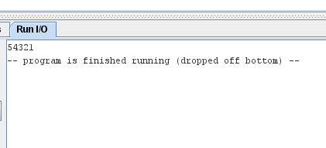
Creating a countdown loop
addi a0, zero, 5
addi a7, zero, 1
loop:
ecall
addi a0, a0, -1
bnez a0, loop

Slide 22
Loops counting up – approach 1
RISC-V assembly code
# s0 = i, s1 = sum
# t0 = limit for counting
# set up the initial values
addi s1, zero, 0
addi s0, zero, 0
addi t0, zero, 10
loop:
bge s0, t0, done
add s1, s1, s0
addi s0, s0, 1
b loop
done:
# print out the sum
Java Code
// add the numbers from 0 to 9
int sum = 0;
int i = 0;
int end = 10;
while (i < end) {
sum = sum + i;
i++;
}
// print out the sum

Slide 23
Loops counting up – approach 2
RISC-V assembly code
# s0 = i, s1 = sum
# t0 = limit for counting
# set up the initial values
addi s1, zero, 0
addi s0, zero, 0
addi t0, zero, 10
loop:
add s1, s1, s0
addi s0, s0, 1
blt s0, t0, loop
# print out the sum
Java Code
// add the numbers from 0 to 9
int sum = 0;
int i = 0;
int end = 10;
while (i < end) {
sum = sum + i;
i++;
}
// print out the sum

Slide 24
What is the final value in s0 after the code has run?
addi s0, zero, 0
addi t0, zero, 3
loop:
addi s0, s0, 1
blt s0, t0, loop

Slide 25
What is the final value in s0 after the code has run?
addi s0, zero, 0
addi t0, zero, 3
loop:
addi s0, s0, 1
ble s0, t0, loop
Notes:
Answer s0 will have 4

Slide 26
What is the final value in s0 after the code has run?
Join: vevox.app ID: 159-043-242
addi s0, zero, 0
addi t0, zero, 3
loop:
addi s0, s0, 1
bge s0, t0, loop

Slide 27
Beware infinite loops
Because we are using an emulator (RARS) we can use the stop button to stop a program that is stuck in an infinite loop
addi s0, zero, 0
addi t0, zero, 3
loop:
addi s0, s0, 3
bge s0, t0, loop

Slide 28
Summary
Standard programming constructs of if/else and loops are all implemented using branch instructions

